Slide 1
Operating System Administration
Liu Cui

Slide 2
Topics
OS Installation
Configuration management
Updates and patches
Event logging and auditing
Managing system services
Backup and resorting data
Network configuration (port security)
Host (workstation/server) intrusion detection
Security policy development

Slide 3
OS Installation
Determining which operating system to install
Check the system requirements
Research your software compatibility
Obtain your new operating system (purchase a copy or download ISO)
Backup your data

Slide 4
OS Installation
Installing your new operating system
Determine your installation order: if you are installing a Linux distribution that you want to run alongside Windows, you need to install Windows first and then Linux. This is because Windows has a very strict boot loader that needs to be in place before Linux is installed, otherwise Windows won’t load
Boot from your installation disc: Insert the installation disc or USB drive and reboot your computer. You need to adjust some settings in your BIOS in order to boot from places other than hard drive. Enter BIOS by hitting F2/F10/F12 and Del. Once you are in the setup menu, navigate to the boot section and set the correct first boot device. Once you’ve selected the correct drive, save your changes and exit setup. Your computer will reboot.
Follow the installation instructions then.

Slide 5
Configuration management
Configuration management (CM) is a system engineering process for establishing and maintaining consistency of a product’s performance, functional, and physical attributes with its requirements, design, and operational information throughout its life.
The CM process for both hardware and software configuration items comprises five distinct disciplines:
CM Planning and Management: a formal document and plan to guide the CM program that includes items such as:
Personnel
Responsibilities and resources
Training requirements
Administrative meeting guidelines
Baselining processes
Configuration control and configuration-status accounting
Naming conventions
Audits and reviews
Subcontractor/vendor CM requirements

Slide 6
Configuration management—Con’t
Configuration identification (CI): consists of setting and maintaining baselines, which define the system or subsystem architecture, components, and any developments at any point in time.
Configuration Control: includes the evaluation of all change-requests and change-proposals, and their subsequent approval or disapproval. It covers the process of controlling modifications to the system’s design, hardware, firmware, software, and documentation.
Configuration Status Accounting: includes the process of recording and reporting configuration item description (e.g. hardware, software, firmware, etc.) and all departures from the baseline during design and production. In the event of suspected problems, the verification of baseline configuration and approved modifications can be quickly determined.
Configuration Verification and Audit: an independent review of hardware and software for the purpose of assessing compliance with established performance requirements, commercial and appropriate military standards, and functional, allocated, and product baselines. Configuration audits verify that the system and subsystem configuration documentation complies with the functional and physical performance characteristics before acceptance into an architectural baseline.

Slide 7
Updates and patches
A patch is a set of changes to a computer program or its supporting data designed to update, fix, or improve it.
Why update system and install patches
fixing security vulnerabilities and other bugs
improving the functionality, usability or performance.

Slide 8
Event logging
Topics:
What is Event Logs
Why monitor Linux log files
Which Linux log files to monitor

Slide 9
Event logging –What is event log
Log files are a set of records that Linux maintains for the administrators to keep track of important events.
They contain messages about the server, including the kernel, services and applications running on it.
Linux provides a centralized repository of log files that can be located under the /var/log directory.

Slide 10
Event logging –What is event log
The log files generated in a Linux environment can typically be classified into four different categories:
Application Logs
Event Logs
Service Logs
System Logs

Slide 11
Event logging –Why monitor Linux log files
Log management is an integral part of any server administrator’s responsibility.
By monitoring Linux log files, you can gain detailed insight on server performance, security, error messages and underlying issues by.
If you want to take a proactive vs. a reactive approach to server management, regular log file analysis is 100% required.
In short, log files allow you to anticipate upcoming issues before they actually occur.

Slide 12
Event logging –which Linux logs to monitor (/var/log/messages)
What’s logged here?
This log file contains generic system activity logs
It is mainly used to store informational and non-critical system messages
How can I use these logs?
Here you can track non-kernel boot errors, application-related service errors and the messages that are logged during system startup
This is the first log file that the Linux administrators should check if something goes wrong
For example, if you are facing some issues with the sound card, to check if something went wrong during the system startup process, you can take a look at the messages stored in this log file.

Slide 13
Event logging –which Linux logs to monitor (/var/log/auth.log)
What’s logged here?
All authentication related events in Debian and Ubuntu server are logged here
If you’re looking for anything involving the user authorization mechanism, you can find it in this log file
How can I use these logs?
Investigate failed login attempts
Investigate brute-force attacks and other vulnerabilities related to user authorization mechanism.

Slide 14
Event logging –which Linux logs to monitor (/var/log/secure)
What’s logged here?
RedHat and CnetOS based systems use this log file instead of /var/log/auth.log
It is mainly used to track the usage of authorization systems
It stores all security related messages including authentication failures
It also tracks sudo logins, SSH logins and other errors logged by system security services daemon
How can I use these logs?
All user authentication events are logged here
This log file can provide detailed insight about unauthorized or failed login attempts
Can be very useful to detect possible hacking attempts
It also stores information about successful logins and tracks the activities of valid users

Slide 15
Event logging –which Linux logs to monitor (/var/log/boot.log)
What’s logged here?
The system initialization script, /etc/init.d/bootmisc.sh, sends all bootup messages to this log file
This is the repository of booting related information and messages logged during system startup process
How can I use these logs?
You should analyze this log file to investigate issues related to improper shutdown, unplanned reboots or booting failures
Can also be useful to determine the duration of system downtime caused by an unexpected shutdown

Slide 16
Event logging –which Linux logs to monitor (/var/log/dmesg)
What’s logged here?
This log file contains Kernel ring buffer messages
Information related to hardware devices and their drivers are logged here
As the kernel detects physical hardware devices associated with the server during the booting process, it captures the device status, hardware errors and other generic messages
How can I use these logs?
This log file is useful for dedicated server customers mostly
If a certain hardware is functioning improperly or not getting detected, then you can rely on this log file to troubleshoot the issue

Slide 17
Event logging –which Linux logs to monitor (/var/log/kern.log)
What’s logged here?
This is a very important log file as it contains information logged by the kernel
How can I use these logs?
Perfect for troubleshooting kernel related errors and warnings
Kernel logs can be helpful to troubleshoot a custom-built kernel
Can also come handy in debugging hardware and connectivity issues

Slide 18
Event logging –which Linux logs to monitor (/var/log/faillog)
What’s logged here?
This file contains information on failed login attempts
How can I use these logs?
It can be a useful log file to find out any attempted security breaches involving username/password hacking and brute-force attacks

Slide 19
Event logging –which Linux logs to monitor (/var/log/cron)
What’s logged here?
This log file records information on cron jobs
Cron is one of the most useful tool in a Linux OS. It is usually used for sysadmin jobs such as backups or cleaning /temp/ directoris and more. The cron service runs in the background
How can I use these logs?
Whenever a cron job runs, this log file records all relevant information including successful execution and error messages in case of failures
If you’re having problems with your scheduled cron, you need to check out this log file

Slide 20
Event logging –which Linux logs to monitor (/var/log/maillog or /var/log/mail.log)
What’s logged here?
All mail server related logs are stored here
How can I use these logs?
Find information about postfix, smtpd, MailScanner, SpamAssassain or any other email related services running on the mail server
Track all the emails that were sent or received during a particular period
Investigate failed mail delivery issues
Get information about possible spamming attempts blocked by the mail server
Trace the origin of an incoming email by scrutinizing this log file

Slide 21
Event logging –which Linux logs to monitor (/var/log/httpd/)
What’s logged here?
This directory contains the logs recorded by the Apache server
Apache server logging information are stored in two different log files –error_log and access_log
How can I use these logs?
The error_log contains messages related to httpd errors such as memory issues and other system related errors
This is the place where Apache server writes events and error records encountered while processing httpd requests
If something goes wrong with the Apache webserver, check this log for diagnostic information
Besides the error-log file, Apache also maintains a separate list of access_log
All access requests received over HTTP are stored in the access_log file
Helps you keep track of every page served and every file loaded by Apache
Logs the IP address and user ID of all clients that make connection requests to the server
Stores information about the status of the access requests, whether a response was sent successfully or the request resulted in a failure.

Slide 22
Event logging –which Linux logs to monitor (/var/log/mysqld.log or /var/log/mysql.log)
What’s logged here?
MySQL log file
All debug, failure and success messages related to the mysqld and mysqld_safe daemon are logged to this file
How can I use these logs?
Use this log to identify problems while starting, running, or stopping mysqld
Get information about client connections to the MySQL data directory
You can also setup ‘long_query_time’ parameter to log information about query locks and slow running queries.

Slide 23
Auditing Linux –auditd
Synopsis
Description
Auditd is the userspace component to the Linux Auditing System. It’s responsible for writing audit records to the disk.
Viewing the logs is done with the ausearch or aureport utilities.
Configuring the audit system or loading rules is done with the auditctl utility

Slide 24
Managing system services
A Linux service is an application (or set of applications) that runs in the background waiting to be used, or carrying out essential tasks, such as Apache and MySQL.
You will generally be unaware of services until you need them.

Slide 25
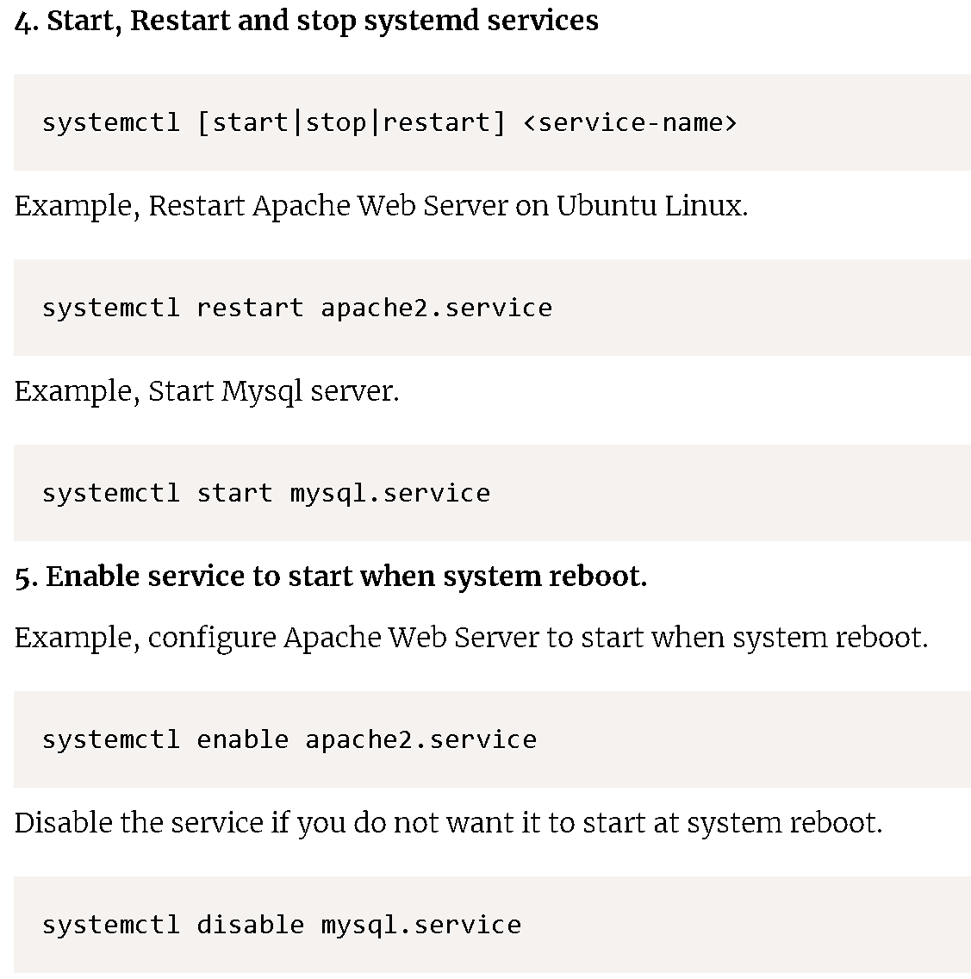
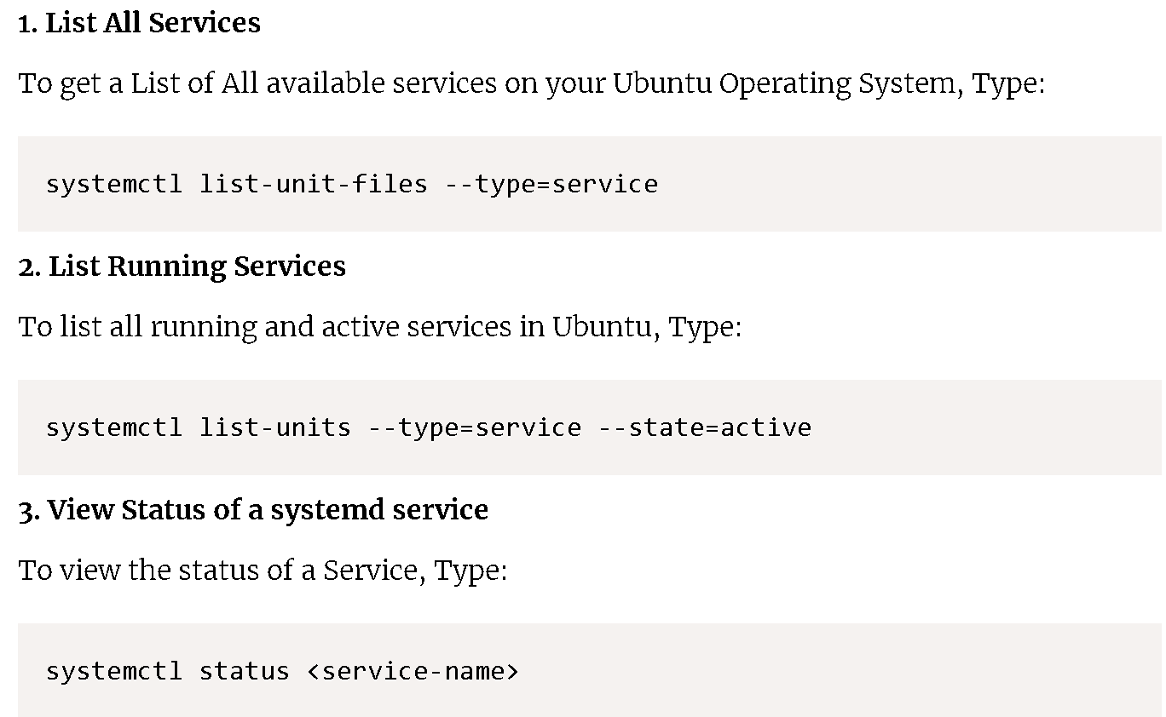
Managing system services –Con’t
Useful command to manage system services

Slide 26
Performing back-ups and restoring the system from a backup
Backup restore using cpio command
Used for single or multiple files backup
Can backup special character & block device files
Works only on mounted file system
Need a list of files to be backed up
Preserve hard links and time stamps of the file
Backup restore using dump package
Allows you to take full and incremental file system backup.
Backup can be taken on a tape, file or a remote system and restore full or selective files

Slide 27
Performing back-ups and restoring the system from a backup
Solaris file system backup restore using ufsdump
Used for complete file system backup
It copies everything from regular files in a file system to special character and block devices files
It can work on mounted or unmounted file system

Slide 28
Filesystem
A filesystem is a way that an operating system organizes files on a disk.
These filesystems come in many different flavors depending on your specific needs.
Windows: NTFS, FAT, FAT16, FAT32
MAC: HFS
Linux: Ext4, Ext3, Ext2, sysfs, securityfs, FAT16, FAT32, NTFS, etc
Mounting a filesystem simply means making the particular filesystem accessible at a certain point in the Linux directory tree.

Slide 29
Filesystem
On Linux OS, you can use the mount command to attach (mount) file systems and removable devices such as USB flash drives at a particular mount point in the directory tree.
The umount command detaches (unmounts) the mounted file system from the directory tree.
For example, to mount the /dev/sdb1 file system to the /mnt/media directory you would use:

Slide 30

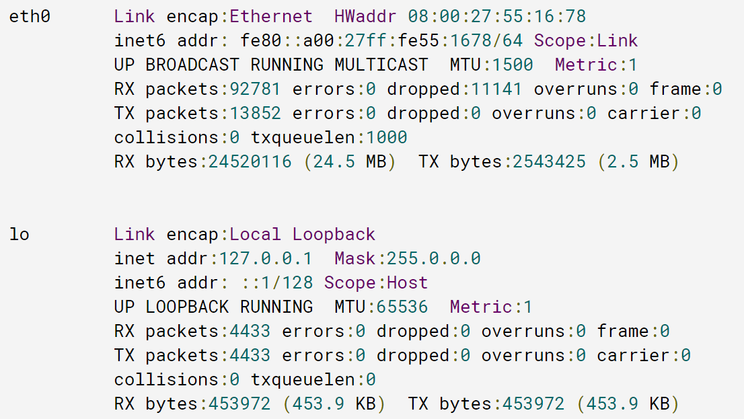
Network configuration
To view your current network parameters via the Terminal, you can use the following command:
It shows all the network interfaces (active and inactive) available on your machine and their parameters.

Slide 31
Network configuration—Con’t
Eth0 is your Ethernet adapter
lo (local loopback) is used to establish a network connection to this machine (127.0.0.1), it does not required additional configuration
To display the settings of a certain interface, use the ifconfig InterfaceName
Ifconfig command also allows to configure the network settings, but the changes made in such a manner, will be reset to default when you restart your machine, so you can use them to temporarily configure the network for testing purposes. For example, you can use the following command to specify the primary IP address and network mask for the eth0 interface:

Slide 32

Network configuration—Con’t
To make the settings persistent, you need to change the network interfaces configuration file located at /etc/network/interfaces
Open it in the text editor
You can see the following settings for a dynamic IP:
To set a static IP for the network interface, replace the ‘dhcp’ value with the ‘static’ one and add some other parameters so that the configuration will look like:

Slide 33
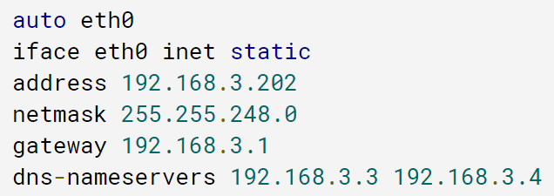
Network configuration—Con’t
auto eth0: specifies that the network interface eth0 should start as the system boots
iface eth0 inet static: specifies that the static IP address is used
Once you have changed the configuration file, you need to restart the network interface as
To verify your machine can connect to a network ping www.wcupa.edu

Slide 34
Network Port Security
Port security helps secure the network by preventing unknown devices from forwarding packets.
When a link goes down, all dynamically locked addresses are freed.
The port security feature offers the following benefits:
You can limit the number of MAC addresses on a given port. Packets that have a matching MAC address (secure packets) are forwarded; all other packets (unsecure packets) are restricted.
You can enable port security on a per port basis

Slide 35
Network Port Security—Con’t
Switches learn MAC addresses when the frame is forwarded through a switch port.
By using port security, user can limit the number of MAC addresses that can be learned to a port, set static MAC addresses and set penalities for that port if it is used by an unauthorized user.
Port security implements two traffic filtering methods, dynamic locking and static locking. These methods can be used concurrently
Dynamic locking: you can specify the maximum number of MAC addresses that can be learned on a port. The maximum number of MAC addresses if platform dependent and is given in the software release nots. After the limit is reached, additional MAC addresses are not learned. Only frames with an allowable source MAC addresses are forwarded.
Static locking: You can manually specify a list of static MAC addresses for a port.

Slide 36
Network Port Security—Con’t
Violation modes
Protect: drops the packets with unknown source mac address until you remove enough secure mac addresses to drop below the maximum value
Restrict: performs the same function as protected, i.e. drops packets until enough secure mac addresses are removed to drop below the maximum value. In addition to this, it will generate a log message, increment the counter value and will also send SNMP trap
Shut down: this mode is mostly preferred as compared to other modes as it shut down the port immediately if unauthorized access is done. It will also generate a log, increment counter value and send a SNMP trap. This port will remain in shut down state until the administrator will perform “no shutdown” command

Slide 37
Host-based Intrusion Detection
Host-based intrusion detection systems are aimed at collecting information about activity on a particular single system, or host.
These host-based agents, which are sometimes referred to as sensors, would typically be installed on a machine that is deemed to be susceptible to possible attacks.
The term “host” refers to an individual computer, thus a separate sensor would be needed for every machine.
Sensors work by collecting data about events taking place on the system being monitored.
This data is recorded by operating system mechanisms called audit trails.

Slide 38
Host-based Intrusion Detection—Con’t
Network-based intrusion detection systems collect information from the network itself rather than from each separate host.
They operate essentially based on a “wiretapping concept,” information is collected from the network traffic stream, as data travels on the network segment.
The intrusion detection system checks for attacks or irregular behavior by inspecting the contents and header information of all the packets moving across the network.
The network sensors come equipped with “attack signatures” that are rules on what will constitute an attack, and most network-based systems allow advanced users to define their own signatures.

Slide 39
Host-based Intrusion Detection—Con’t
Intrusion detection methods
Signature-based intrusion detection works by analyzing data for specific patterns that have been associated with intrusion attempts. This is similar to traditional virus protection system which rely on virus definitions. Likewise, signature-based intrusion detection relies on intrusion signatures or patterns. They compare data with intrusion signatures to identify attempts. Their main drawback is that they don’t work until the proper signatures are uploaded into the software. Unfortunately, this typically happens only after a certain number of machines have been attacked and publishers of intrusion signatures have had time to publish new update packages. Some suppliers are quite fast while others could only react days later.

Slide 40
Host-based Intrusion Detection—Con’t
Anomaly-based intrusion detection, the other method, provides better protection against zero-day attacks, those that happen before any intrusion detection software has had a chance to acquire the proper signature file. These systems look for anomalies instead of trying to recognize known intrusion patterns. For example, they could be triggered if someone tried to access a system with a wrong password several times in a row, a common sign of a brute force attack. Any suspicious behavior can quickly be detected.
Examples of host intrusion detection tools
SolarWinds Log & Event Manager
Open Source Security (OSSEC)
Samhain
Fail2Ban
Advanced Intrusion Detection Environment (AIDE)
Sagan

Slide 41
Security policy development
An Security policy should
Protect people and information
Set the rules for expected behavior by users, system administrators, management, and security personnel
Authorized security personnel to monitor, probe, and investigate
Define and authorize the consequences of violations
Define the company consensus baseline stance on security
Help minimize risk
Help track compliance with regulations and legislation
Ensure the confidentiality, integrity and availability of their data
Provide a framework within which employees can work, are a reference for best practices, and are used to ensure users comply with legal requirements

Slide 42
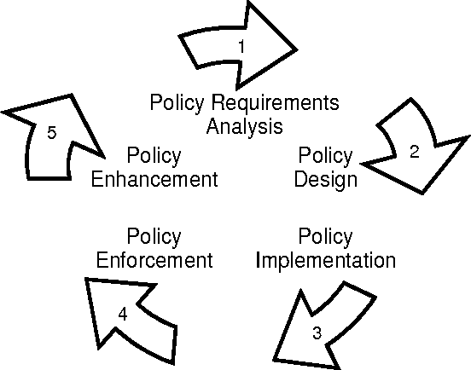
Security policy development—Con’t
Life cycle

Slide 43
Security policy development—Con’t
Elements of a solid security policy
The policy should define the risks to your data, whether it is digital or on paper. It should mitigate these risks by defining a variety of safeguards to protect this data
It should define how users access the data, whether on site or digitally
It should also define a series of consequences for violating these policies
It should detail how employees will be trained to defend against a cyber attack
It should mitigate risk by defining what happens in the event of a cyber breach, employee theft, or any other event that causes a loss or threat to data
It needs to detail which solutions your organization will use to defend against threats
It should establish governance for the policies and how often they should be reviewed.

Slide 44
Security policy development—Con’t
Security policies need to
Reflect the reality on the ground
Be simple to understand
Be enforceable but flexible
Be measurable
Minimize unintended consequences

